Slide 1

UNIVERSITY INSTITUTE OF ENGINEERING
COMPUTER SCIENCE ENGINEERING
Machine Learning
23CSH-651
By
Dr. Meena Pundir
INTRODUCTION
DISCOVER . LEARN . EMPOWER

Slide 2
Decision Trees
A hierarchical data structure that represents data by implementing a divide and conquer strategy
Can be used as a non-parametric classification and regression method (real numbers associated with each example, rather than a categorical label)
Process:
Given a collection of examples, learn a decision tree that represents it.
Use this representation to classify new examples
Given this collection of shapes, what shapes are type A, B, and C?
C
B
A

Slide 3
The Representation
Decision Trees are classifiers for instances represented as feature vectors
color={red, blue, green} ; shape={circle, triangle, rectangle} ; label= {A, B, C}
An example: <(color = green; shape = rectangle), label = B>
Nodes are tests for feature values
There is one branch for each value of the feature
Leaves specify the category (labels)
Can categorize instances into multiple disjoint categories
Learning a
Decision Tree?
Check the color
feature.
If it is blue than check the shape feature
if it is …then…
Color
Evaluation of a
Decision Tree
C
B
A
Shape
B
Shape
B
A
C
B
A

Slide 4
Expressivity of Decision Trees
As Boolean functions they can represent any Boolean function.
Can be rewritten as rules in Disjunctive Normal Form (DNF)
Green ∧ Square → positive
Blue ∧ Circle → positive
Blue ∧ Square → positive
The disjunction of these rules is equivalent to the Decision Tree
What did we show? What is the hypothesis space here?
2 dimensions: color and shape
3 values each: color(red, blue, green), shape(triangle, square, circle)
|X| = 9: (red, triangle), (red, circle), (blue, square) …
|Y| = 2: + and -
|H| = 2⁹
And, all these functions can be represented as decision trees.
Color
Shape
B
Shape
-
+
+
+
-

Slide 5
Decision Trees
Output is a discrete category. Real valued outputs are possible (regression trees)
There are efficient algorithms for processing large amounts of data (but not too many features)
There are methods for handling noisy data (classification noise and attribute noise) and for handling missing attribute values
Color
Shape
B
Shape
-
+
+
+
-

Slide 6
Decision Boundaries
Usually, instances are represented as attribute-value pairs (color=blue, shape = square, +)
Numerical values can be used either by discretizing or by using thresholds for splitting nodes
In this case, the tree divides the features space into axis-parallel rectangles, each labeled with one of the labels
X < 3
Y
no
yes
+
+
+
7
Y > 7
Y < 5
+
+
-
no
yes
no
yes
5
-
+
-
-
+
+
X < 1
no
yes
1 3 X
+
-

Slide 7
Decision Trees
Can represent any Boolean Function
Can be viewed as a way to compactly represent a lot of data.
Natural representation: (20 questions)
The evaluation of the Decision Tree Classifier is easy
Clearly, given data, there are
many ways to represent it as
a decision tree.
Learning a good representation
from data is the challenge.
Outlook
Sunny
Overcast
Rain
Humidity
Wind
Yes
High
Normal
Strong
Weak
No
Yes
No
Yes

Slide 8
Will I play tennis today?
Features
Outlook: {Sun, Overcast, Rain}
Temperature: {Hot, Mild, Cool}
Humidity: {High, Normal, Low}
Wind: {Strong, Weak}
Labels
Binary classification task: Y = {+, -}

Slide 9
Will I play tennis today?
 | O | T | H | W | Play?
1 | S | H | H | W | -
2 | S | H | H | S | -
3 | O | H | H | W | +
4 | R | M | H | W | +
5 | R | C | N | W | +
6 | R | C | N | S | -
7 | O | C | N | S | +
8 | S | M | H | W | -
9 | S | C | N | W | +
10 | R | M | N | W | +
11 | S | M | N | S | +
12 | O | M | H | S | +
13 | O | H | N | W | +
14 | R | M | H | S | -
Outlook: S(unny), O(vercast), R(ainy)
Temperature: H(ot), M(edium), C(ool)
Humidity: H(igh), N(ormal), L(ow)
Wind: S(trong), W(eak)

Slide 10
Basic Decision Trees Learning Algorithm
 | O | T | H | W | Play?
1 | S | H | H | W | -
2 | S | H | H | S | -
3 | O | H | H | W | +
4 | R | M | H | W | +
5 | R | C | N | W | +
6 | R | C | N | S | -
7 | O | C | N | S | +
8 | S | M | H | W | -
9 | S | C | N | W | +
10 | R | M | N | W | +
11 | S | M | N | S | +
12 | O | M | H | S | +
13 | O | H | N | W | +
14 | R | M | H | S | -
Data is processed in Batch (i.e. all the data available)
Recursively build a decision tree top down.
Algorithm?
Outlook
Sunny
Overcast
Rain
Humidity
Yes
Wind
High
Normal
Strong
Weak
No
Yes
No
Yes

Slide 11
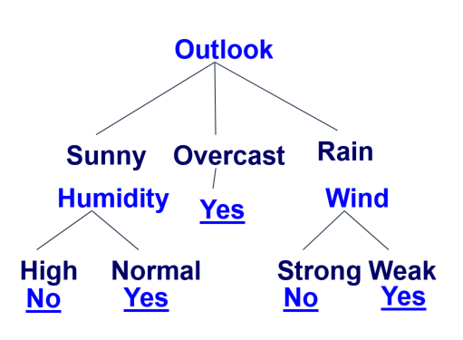
Basic Decision Tree Algorithm
Let S be the set of Examples
Label is the target attribute (the prediction)
Attributes is the set of measured attributes
ID3(S, Attributes, Label)
If all examples are labeled the same return a single node tree with Label
Otherwise Begin
A = attribute in Attributes that best classifies S (Create a Root node for tree)
for each possible value v of A
Add a new tree branch corresponding to A=v
Let Sv be the subset of examples in S with A=v
if Sv is empty: add leaf node with the common value of Label in S
Else: below this branch add the subtree
ID3(Sv, Attributes - {a}, Label)
End
Return Root
why?
For evaluation time

Slide 12
Picking the Root Attribute
The goal is to have the resulting decision tree as small as possible (Occam’s Razor)
But, finding the minimal decision tree consistent with the data is NP-hard
The recursive algorithm is a greedy heuristic search for a simple tree, but cannot guarantee optimality.
The main decision in the algorithm is the selection of the next attribute to condition on.

Slide 13
Picking the Root Attribute
Consider data with two Boolean attributes (A,B).
< (A=0,B=0), - >: 50 examples
< (A=0,B=1), - >: 50 examples
< (A=1,B=0), - >: 0 examples
< (A=1,B=1), + >: 100 examples
What should be the first attribute we select?
Notes:
One

Slide 14
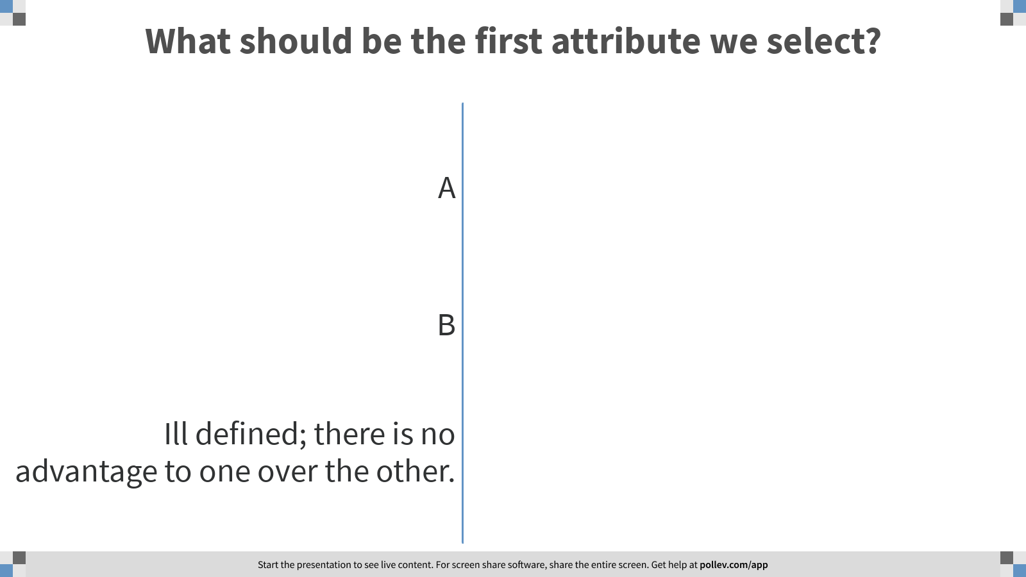
Notes:
Poll Title: What should be the first attribute we select? https://www.polleverywhere.com/multiple_choice_polls/o4pcaU3XGtbD6WgVa8GTe?flow=Default&onscreen=persist

Slide 15
Picking the Root Attribute
Consider data with two Boolean attributes (A,B).
< (A=0,B=0), - >: 50 examples
< (A=0,B=1), - >: 50 examples
< (A=1,B=0), - >: 0 examples
< (A=1,B=1), + >: 100 examples
What should be the first attribute we select?
Splitting on A: we get purely labeled nodes.
Splitting on B: we don’t get purely labeled nodes.
What if we have: <(A=1,B=0), - >: 3 examples?
(one way to think about it: # of queries required to label a random data point)
A
1
0
+
-
splitting on A
B
1
0
A
-
1
0
+
-
splitting on B
Notes:
One

Slide 16
Picking the Root Attribute
Consider data with two Boolean attributes (A,B).
< (A=0,B=0), - >: 50 examples
< (A=0,B=1), - >: 50 examples
< (A=1,B=0), - >: 0 examples 3 examples
< (A=1,B=1), + >: 100 examples
What should be the first attribute we select?

Slide 17
Notes:
Poll Title: What should be the first attribute we select? https://www.polleverywhere.com/multiple_choice_polls/o4pcaU3XGtbD6WgVa8GTe?flow=Default&onscreen=persist

Slide 18
Picking the Root Attribute
Consider data with two Boolean attributes (A,B).
< (A=0,B=0), - >: 50 examples
< (A=0,B=1), - >: 50 examples
< (A=1,B=0), - >: 0 examples 3 examples
< (A=1,B=1), + >: 100 examples
What should be the first attribute we select?
Trees looks structurally similar; which attribute should we choose?
Advantage A. But…
Need a way to quantify things
One way to think about it: # of queries required to
label a random data point.
If we choose A we have less uncertainty about
the labels.
A
B
1
0
1
0
B
-
A
-
1
0
100
1
0
53
+
-
+
-
100
3
100
50
splitting on A
splitting on B

Slide 19
Picking the Root Attribute
The goal is to have the resulting decision tree as small as possible (Occam’s Razor)
The main decision in the algorithm is the selection of the next attribute to condition on.
We want attributes that split the examples to sets that are relatively pure in one label; this way we are closer to a leaf node.
The most popular heuristics is based on information gain, originated with the ID3 system of Quinlan.

Slide 20
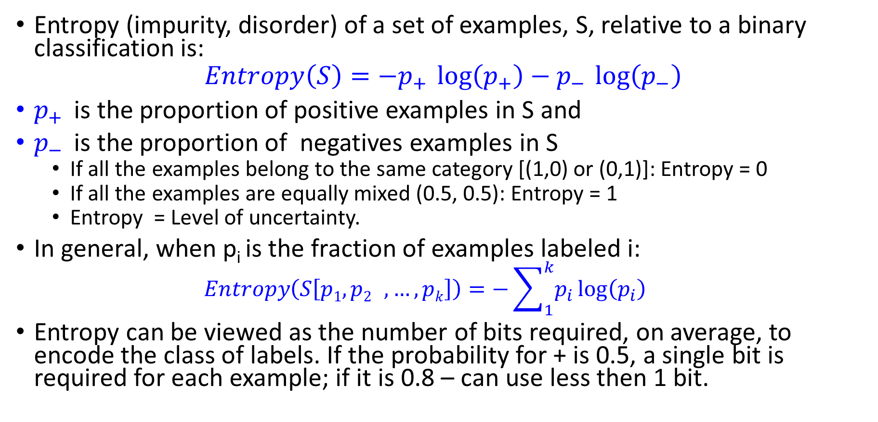
Entropy
Entropy (impurity, disorder) of a set of examples, S, relative to a binary classification is:
$$Entropy\left(S\right)=−p_{+ }\log\left(p_{+}\right)−p_{− }\log\left(p_{−}\right)$$
$p_{+ }$is the proportion of positive examples in S and
$p_{− }$is the proportion of negatives examples in S
If all the examples belong to the same category [(1,0) or (0,1)]: Entropy = 0
If all the examples are equally mixed (0.5, 0.5): Entropy = 1
Entropy = Level of uncertainty.
In general, when p_{i} is the fraction of examples labeled i:
$$Entropy\left(S\left[p1,p2 ,…,pk\right]\right)=−\sum_{1}^{k}{p_{i}}\log\left(p_{i}\right)$$
Entropy can be viewed as the number of bits required, on average, to encode the class of labels. If the probability for + is 0.5, a single bit is required for each example; if it is 0.8 – can use less then 1 bit.

Slide 21
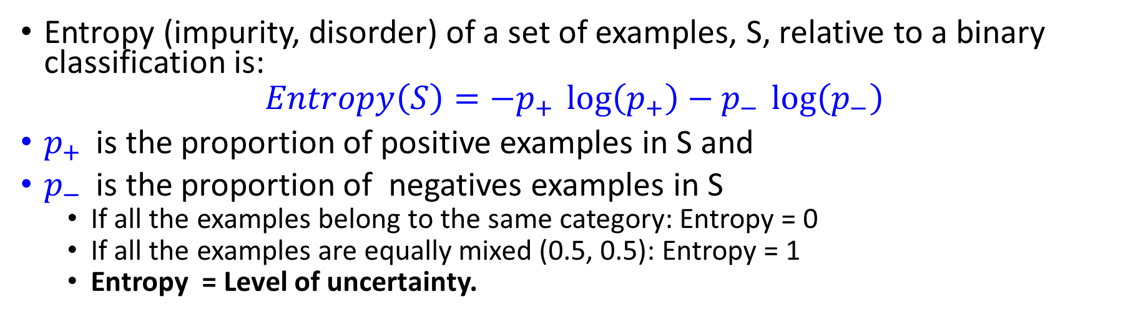
Entropy
Entropy (impurity, disorder) of a set of examples, S, relative to a binary classification is:
$$Entropy\left(S\right)=−p_{+ }\log\left(p_{+}\right)−p_{− }\log\left(p_{−}\right)$$
$p_{+ }$is the proportion of positive examples in S and
$p_{− }$is the proportion of negatives examples in S
If all the examples belong to the same category: Entropy = 0
If all the examples are equally mixed (0.5, 0.5): Entropy = 1
Entropy = Level of uncertainty.
Test yourself: assign high, medium, low to each of these distributions
1
1
1
--
+
--
+
--
+

Slide 22


Entropy
(Convince yourself that the max value would be $\log\left(k\right)$ )
(Also note that the base of the log only introduces a constant factor; therefore, we’ll think about base 2)
Test yourself again: assign high, medium, low to each of these distributions.
For the middle distribution, try to guess the value of the entropy.
1
1
1

Slide 23
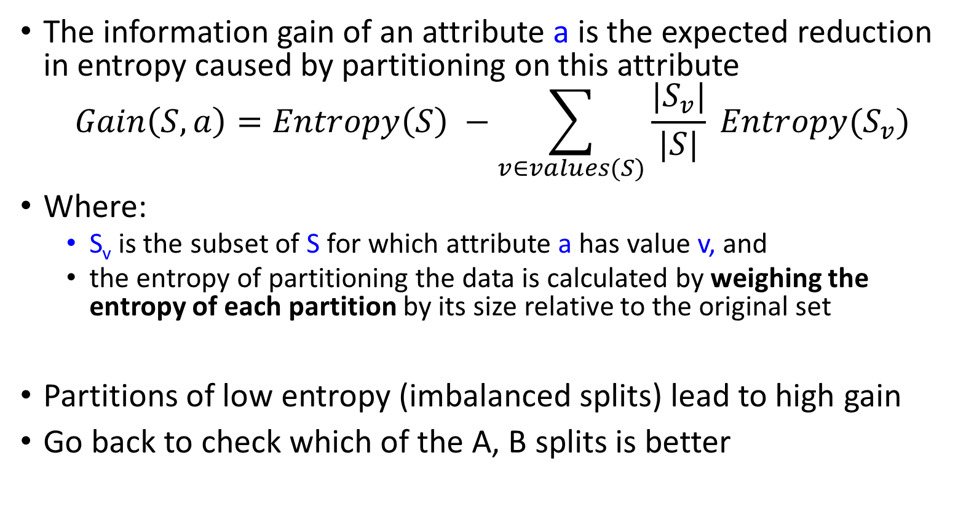
Information Gain
High Entropy – High level of Uncertainty
Low Entropy – No Uncertainty.
The information gain of an attribute a is the expected reduction in entropy caused by partitioning on this attribute
$$Gain\left(S,a\right)=Entropy\left(S\right) −\sum_{v∈values(S)}{\frac{|S_{v}|}{|S|} Entropy(S_{v})}$$
Where:
S_{v} is the subset of S for which attribute a has value v, and
the entropy of partitioning the data is calculated by weighing the entropy of each partition by its size relative to the original set
Partitions of low entropy (imbalanced splits) lead to high gain
Go back to check which of the A, B splits is better
Outlook
Sunny
Overcast
Rain
Notes:
The A, B case:
If we choose A: the reduction is: 100/203 Ent(100,0) + 103/203 Ent(100,3) ~~ 0
If we choose B: the reduction is: 53/203 Ent(53,0) + 150/203 Ent(100,50) >> 0

Slide 24
Administration (9/21/20)
Are we recording? YES!
Available on the web site
Remember that all the lectures are available on the website before the class
Go over it and be prepared
HW 1 was released on Monday
Covers: SGD, DT, Feature Extraction, Ensemble Models, & Experimental Machine Learning
Start working on it now. Don’t wait until the last day (or two) since it could take a lot of your time
Go to the recitations and office hours
No Class on Monday 9/28 for Yom Kippur
Questions?
Please ask/comment during class.
Give us feedback

Slide 25
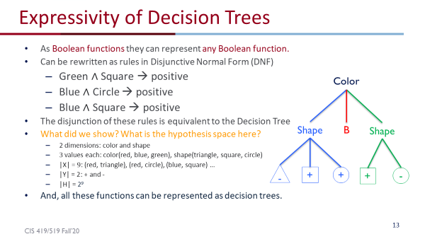
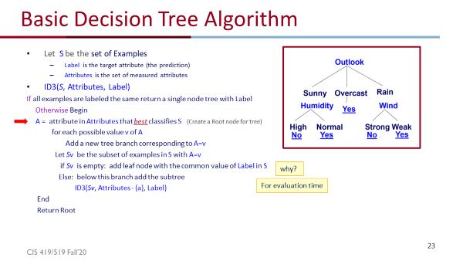
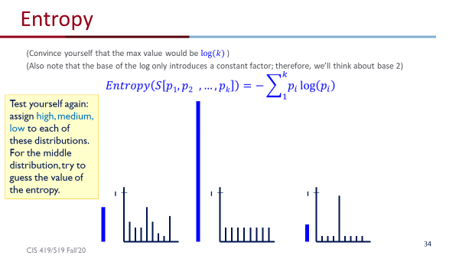
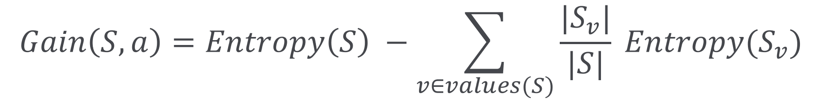
What Have We Done?
Decision Trees
Expressivity
A Recursive Decision Tree Algorithm
Entropy and Information Gain

Slide 26
Will I play tennis today?
 | O | T | H | W | Play?
1 | S | H | H | W | -
2 | S | H | H | S | -
3 | O | H | H | W | +
4 | R | M | H | W | +
5 | R | C | N | W | +
6 | R | C | N | S | -
7 | O | C | N | S | +
8 | S | M | H | W | -
9 | S | C | N | W | +
10 | R | M | N | W | +
11 | S | M | N | S | +
12 | O | M | H | S | +
13 | O | H | N | W | +
14 | R | M | H | S | -
Outlook: S(unny), O(vercast), R(ainy)
Temperature: H(ot), M(edium), C(ool)
Humidity: H(igh), N(ormal), L(ow)
Wind: S(trong), W(eak)

Slide 27

Will I play tennis today?
 | O | T | H | W | Play?
1 | S | H | H | W | -
2 | S | H | H | S | -
3 | O | H | H | W | +
4 | R | M | H | W | +
5 | R | C | N | W | +
6 | R | C | N | S | -
7 | O | C | N | S | +
8 | S | M | H | W | -
9 | S | C | N | W | +
10 | R | M | N | W | +
11 | S | M | N | S | +
12 | O | M | H | S | +
13 | O | H | N | W | +
14 | R | M | H | S | -
calculate current entropy
$p_{+ }= \frac{9}{14}$ ${ p}_{− }= \frac{5}{14}$
$Entropy\left(Play\right)=−p_{+ }\log{2\left(p_{+}\right)}−p_{− }\log{2\left(p_{−}\right)}$ $=−\frac{9}{14}log2\frac{9}{14}−\frac{5}{14}log2\frac{5}{14}$
≈ 0.94

Slide 28
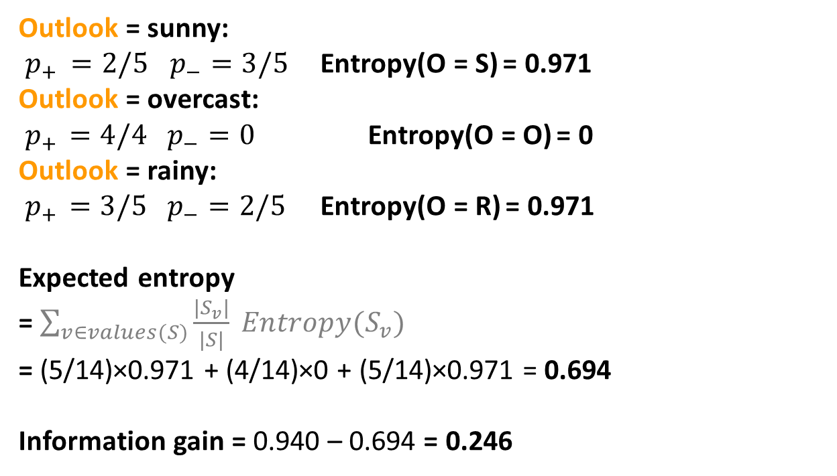
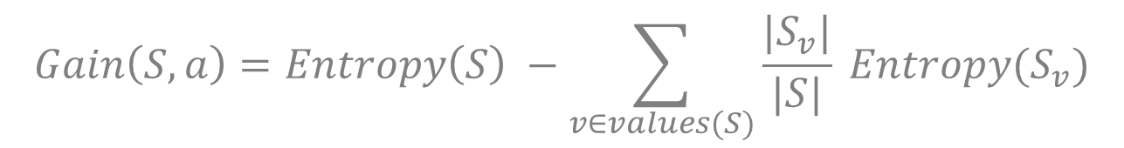
Information Gain: Outlook
$$Gain\left(S,a\right)=Entropy\left(S\right) −\sum_{v∈values(S)}{\frac{|S_{v}|}{|S|} Entropy(S_{v})}$$
 | O | T | H | W | Play?
1 | S | H | H | W | -
2 | S | H | H | S | -
3 | O | H | H | W | +
4 | R | M | H | W | +
5 | R | C | N | W | +
6 | R | C | N | S | -
7 | O | C | N | S | +
8 | S | M | H | W | -
9 | S | C | N | W | +
10 | R | M | N | W | +
11 | S | M | N | S | +
12 | O | M | H | S | +
13 | O | H | N | W | +
14 | R | M | H | S | -
Outlook = sunny: $p_{+ }=2/5$ $p_{−}=3/5$ Entropy(O = S) = 0.971 Outlook = overcast:
${ p}_{+ } =4/4$ $p_{−}=0$ Entropy(O = O) = 0
Outlook = rainy:
${ p}_{+ } =3/5$ $p_{−}=2/5$ Entropy(O = R) = 0.971
Expected entropy
= $\sum_{v∈values(S)}{\frac{|S_{v}|}{|S|} Entropy(S_{v})}$
= (5/14)×0.971 + (4/14)×0 + (5/14)×0.971 = 0.694
Information gain = 0.940 – 0.694 = 0.246

Slide 29
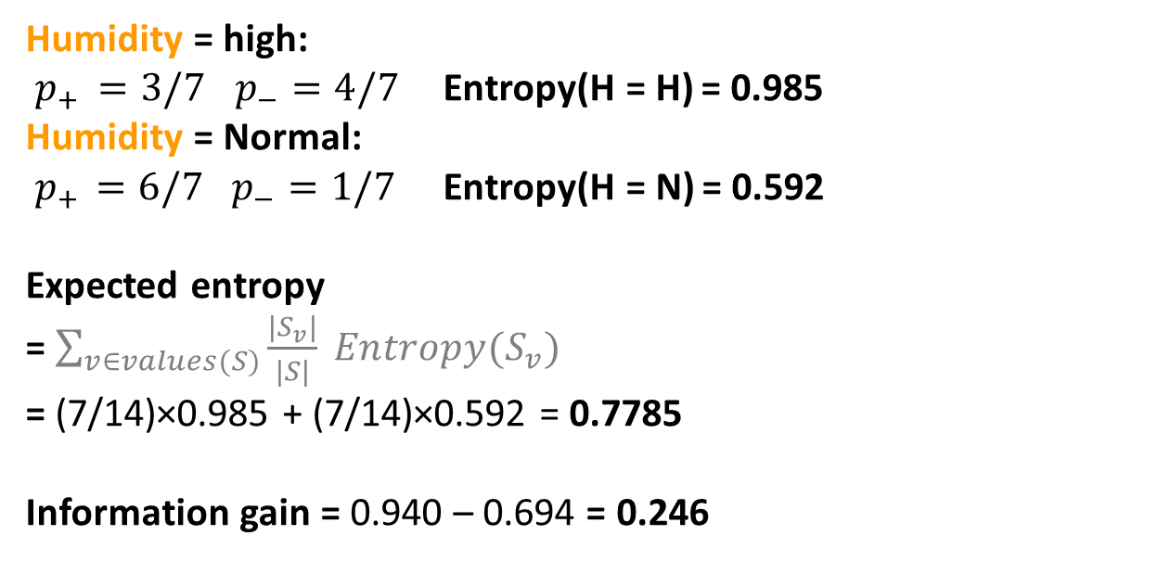
Information Gain: Humidity
$$Gain\left(S,a\right)=Entropy\left(S\right) −\sum_{v∈values(S)}{\frac{|S_{v}|}{|S|} Entropy(S_{v})}$$
 | O | T | H | W | Play?
1 | S | H | H | W | -
2 | S | H | H | S | -
3 | O | H | H | W | +
4 | R | M | H | W | +
5 | R | C | N | W | +
6 | R | C | N | S | -
7 | O | C | N | S | +
8 | S | M | H | W | -
9 | S | C | N | W | +
10 | R | M | N | W | +
11 | S | M | N | S | +
12 | O | M | H | S | +
13 | O | H | N | W | +
14 | R | M | H | S | -
Humidity = high: $p_{+ }=3/7$ $p_{−}=4/7$ Entropy(H = H) = 0.985 Humidity = Normal:
${ p}_{+ } =6/7$ $p_{−}=1/7$ Entropy(H = N) = 0.592
Expected entropy
= $\sum_{v∈values(S)}{\frac{|S_{v}|}{|S|} Entropy(S_{v})}$
= (7/14)×0.985 + (7/14)×0.592 = 0.7785
Information gain = 0.940 – 0.694 = 0.246

Slide 30
Which feature to split on?
 | O | T | H | W | Play?
1 | S | H | H | W | -
2 | S | H | H | S | -
3 | O | H | H | W | +
4 | R | M | H | W | +
5 | R | C | N | W | +
6 | R | C | N | S | -
7 | O | C | N | S | +
8 | S | M | H | W | -
9 | S | C | N | W | +
10 | R | M | N | W | +
11 | S | M | N | S | +
12 | O | M | H | S | +
13 | O | H | N | W | +
14 | R | M | H | S | -
Information gain: Outlook: 0.246 Humidity: 0.151 Wind: 0.048 Temperature: 0.029
→ Split on Outlook

Slide 31
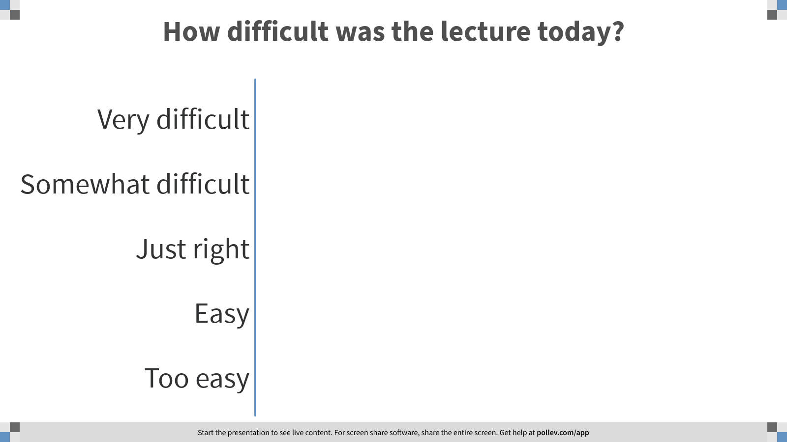
Notes:
Poll Title: How difficult was the lecture today? https://www.polleverywhere.com/multiple_choice_polls/NZ7gbOibqs6U3BIbkFlse?flow=Default&onscreen=persist

Slide 32
An Illustrative Example (III)
Gain(S,Humidity)=0.151
Gain(S,Wind) = 0.048
Gain(S,Temperature) = 0.029
Gain(S,Outlook) = 0.246
Outlook

Slide 33
An Illustrative Example (III)
 | O | T | H | W | Play?
1 | S | H | H | W | -
2 | S | H | H | S | -
3 | O | H | H | W | +
4 | R | M | H | W | +
5 | R | C | N | W | +
6 | R | C | N | S | -
7 | O | C | N | S | +
8 | S | M | H | W | -
9 | S | C | N | W | +
10 | R | M | N | W | +
11 | S | M | N | S | +
12 | O | M | H | S | +
13 | O | H | N | W | +
14 | R | M | H | S | -
Outlook
Sunny
Overcast
Rain
1,2,8,9,11
3,7,12,13
4,5,6,10,14
2+,3-
4+,0-
3+,2-
?
Yes
?

Slide 34
An Illustrative Example (III)
Outlook
 | O | T | H | W | Play?
1 | S | H | H | W | -
2 | S | H | H | S | -
3 | O | H | H | W | +
4 | R | M | H | W | +
5 | R | C | N | W | +
6 | R | C | N | S | -
7 | O | C | N | S | +
8 | S | M | H | W | -
9 | S | C | N | W | +
10 | R | M | N | W | +
11 | S | M | N | S | +
12 | O | M | H | S | +
13 | O | H | N | W | +
14 | R | M | H | S | -
Sunny
Overcast
Rain
1,2,8,9,11
3,7,12,13
4,5,6,10,14
2+,3-
4+,0-
3+,2-
?
Yes
?
Continue until:
Every attribute is included in path, or,
All examples in the leaf have same label

Slide 35
An Illustrative Example (IV)
Outlook
 | O | T | H | W | Play?
1 | S | H | H | W | -
2 | S | H | H | S | -
4 | R | M | H | W | +
5 | R | C | N | W | +
6 | R | C | N | S | -
7 | O | C | N | S | +
8 | S | M | H | W | -
9 | S | C | N | W | +
10 | R | M | N | W | +
11 | S | M | N | S | +
12 | O | M | H | S | +
13 | O | H | N | W | +
14 | R | M | H | S | -
Sunny
Overcast
Rain
1,2,8,9,11
3,7,12,13
4,5,6,10,14
2+,3-
4+,0-
3+,2-
?
Yes
?
.97-(3/5) 0-(2/5) 0 = .97
.97- 0-(2/5) 1 = .57
.97-(2/5) 1 - (3/5) .92= .02
Split on Humidity

Slide 36
An Illustrative Example (V)
Outlook
Sunny
Overcast
Rain
1,2,8,9,11
3,7,12,13
4,5,6,10,14
2+,3-
4+,0-
3+,2-
?
Yes
?

Slide 37
An Illustrative Example (V)
Outlook
Sunny
Overcast
Rain
1,2,8,9,11
3,7,12,13
4,5,6,10,14
2+,3-
4+,0-
3+,2-
Humidity
Yes
?
High
Normal
No
Yes

Slide 38
induceDecisionTree(S)
1. Does S uniquely define a class? if all s ∈ S have the same label y: return S;
2. Find the feature with the most information gain:
i = argmax _{i} Gain(S, X_{i})
3. Add children to S:
for k in Values(X_{i}):
S_{k} = {s ∈ S | x_{i} = k} addChild(S, S_{k})
induceDecisionTree(S_{k})
return S;

Slide 39
An Illustrative Example (VI)
Outlook
Sunny
Overcast
Rain
1,2,8,9,11
3,7,12,13
4,5,6,10,14
2+,3-
4+,0-
3+,2-
Humidity
Yes
Wind
High
Normal
Strong
Weak
No
Yes
No
Yes

